Slide 1
Meowtion
ON-DEVICE AI
#HACKTHEKITTY 2026

Slide 2
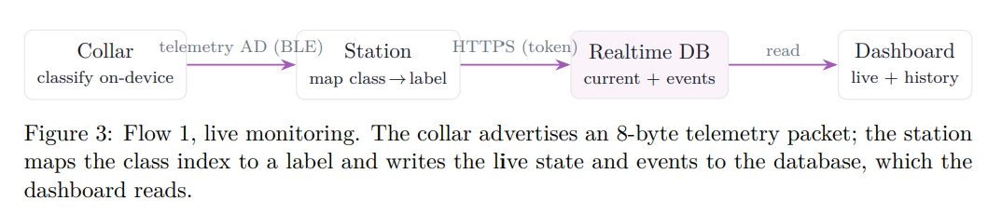
Meowtion
#HACKTHEKITTY 2026
Notes:
All classification happens on the collar in real time

Slide 3
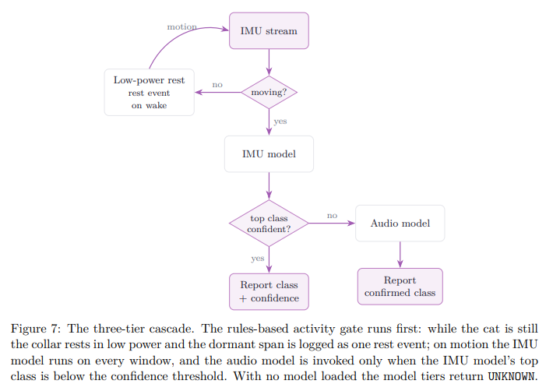
Meowtion
#HACKTHEKITTY 2026
Notes:
And Meowtion runs a confidence gated cascade of two models

Slide 4
Meowtion
#HACKTHEKITTY 2026
Notes:
And Meowtion runs a confidence gated cascade of two models

Slide 5
Meowtion
#HACKTHEKITTY 2026
Notes:
to identify between behaviours which may look identical to a motion sensor but sound completely different

Slide 6
Meowtion
#HACKTHEKITTY 2026
Notes:
The IMU model

Slide 7
Meowtion
#HACKTHEKITTY 2026
Notes:
The IMU model runs continuously

Slide 8
Meowtion
#HACKTHEKITTY 2026
Notes:
The IMU model runs continuously on the motion stream

Slide 9
Meowtion
#HACKTHEKITTY 2026
Notes:
It is cheap

Slide 10
Meowtion
#HACKTHEKITTY 2026
Notes:
Always on

Slide 11
Meowtion
#HACKTHEKITTY 2026
Notes:
And carries most of the classification load

Slide 12
Meowtion
#HACKTHEKITTY 2026
Notes:
when the IMU is unsure

Slide 13
Meowtion
#HACKTHEKITTY 2026
Notes:
the short audio model is invoked to confirm class

Slide 14
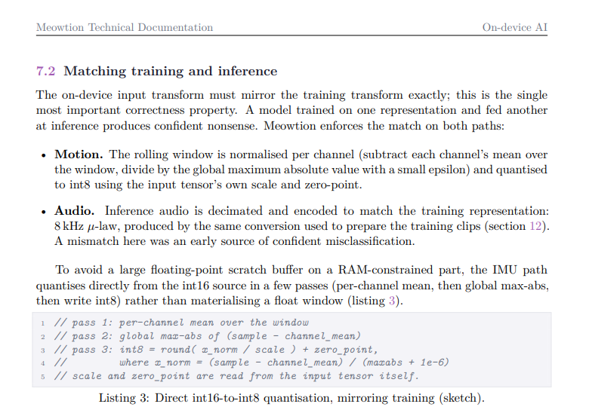
Meowtion
#HACKTHEKITTY 2026
Notes:
audio is therefore a deployed disambiguation signal, not merely a training aid

Slide 15

Meowtion
#HACKTHEKITTY 2026
Notes:
this keeps average power low while recovering accuracy that motion alone cannot provide

Slide 16
Meowtion
#HACKTHEKITTY 2026
Notes:
so how does it train?

Slide 17
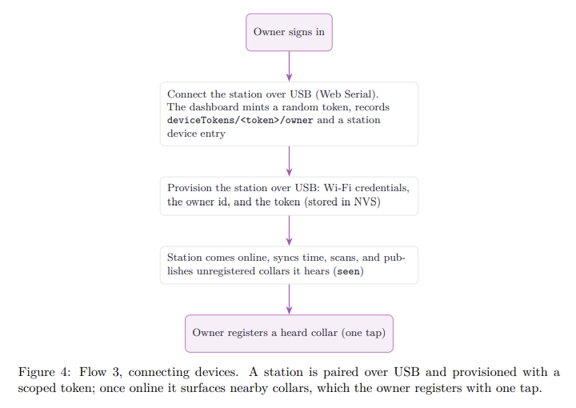
Meowtion
#HACKTHEKITTY 2026
Notes:
Meowtion learns new behaviours defined by the human entirely from the dashboard with no local toolchain.

Slide 18
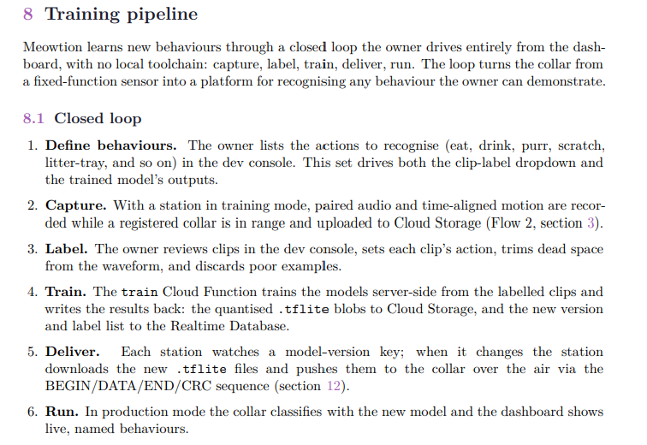
Meowtion
#HACKTHEKITTY 2026
Notes:
Meowtion learns new behaviours defined by the human entirely from the dashboard with no local toolchain.

Slide 19
Meowtion
#HACKTHEKITTY 2026
Notes:
capture

Slide 20
Meowtion
#HACKTHEKITTY 2026
Notes:
label

Slide 21
Meowtion
#HACKTHEKITTY 2026
Notes:
Train

Slide 22
Meowtion
#HACKTHEKITTY 2026
Notes:
deliver

Slide 23
Meowtion
#HACKTHEKITTY 2026
Notes:
run

Slide 24
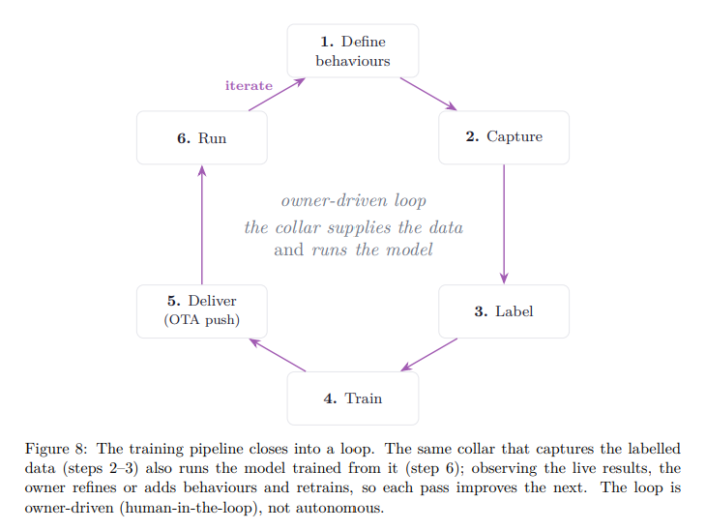
Meowtion
#HACKTHEKITTY 2026
Notes:
The loop turns the collar from a fixed function sensor into a platform for recognising any behaviour the owner can demonstrate

Slide 25
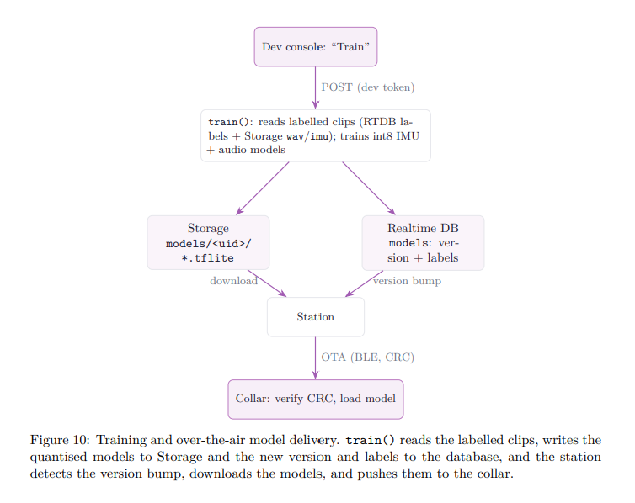
Meowtion
#HACKTHEKITTY 2026
Notes:
Training runs in the train Python cloud function

Slide 26
Meowtion
#HACKTHEKITTY 2026
Notes:
it reads the account’s labelled clips and derives the class set directly from the labels present

Slide 27
Meowtion
#HACKTHEKITTY 2026
Notes:
it then trains the two cascade stages independently

Slide 28
Meowtion
#HACKTHEKITTY 2026
Notes:
it then trains the two cascade stages independently

Slide 29
Meowtion
#HACKTHEKITTY 2026
Notes:
This is the whole path, from the training trigger to the model running on the collar

